Slide 1
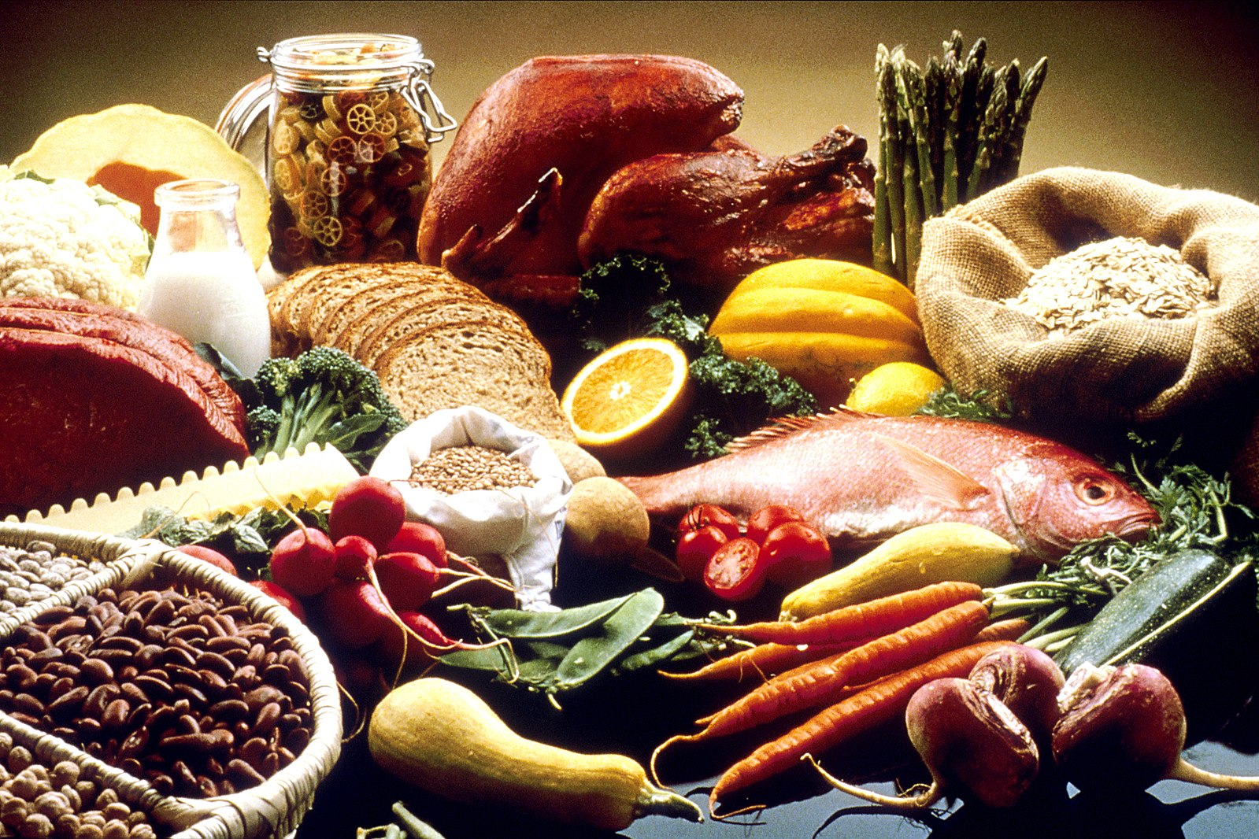
Relationships between U.S. Food Imports in 2022
Daniel Brilliant
May 3, 2023

Slide 2

Chosen Dataset
Summary data on annual food imports, values and volume by food category and source country, 1999-2022
Source: USDA Economic Research Service
Units of Analysis: Food Import Value by country/food group, Food Import Volume by country/food group
Geographic Scope of Dataset: Worldwide
Time Frame of Dataset: 1999-2022
Total Number of Observations: 15384
Observations Used: 14

Slide 3

Motivation and research question
Food import values, in theory, should be related by their means of production. These import values are important to everyone, as these values affect the cost of groceries and goods that all people consume to survive.
How do food imports relate to one another when comparing value, volume, country, and/or related sources of production?

Slide 4
Variables, hypotheses, and methods
Variables: Food import value (dependent variable), food import volume (independent variable)
Null Hypothesis: In 2022, there was no association between food import value and food import volume
Alternative Hypothesis: In 2022, there was an association between food import value and food import volume
Simple linear regression hypothesis test

Slide 5
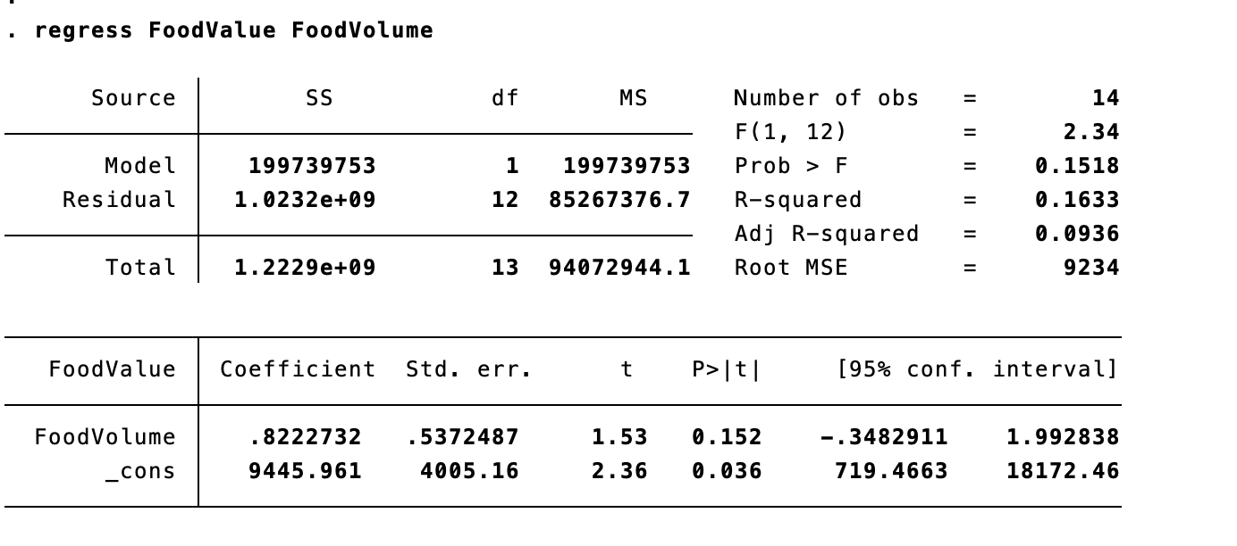
Preliminary results
Alpha level = 0.05, P-value > alpha, fail to reject the null hypothesis

Slide 6
Citation
https://www.ers.usda.gov/data-products/u-s-food-imports/

